Slide 1

NEPeTI: Aplicando a Computação na Educação Básica do Cerrado
Chamada Pública IFES/SETEC/MEC nº 88/2022

Slide 2



Slide 3


Slide 4


PictoBlox
Software de programação gráfica baseado em Scratch 3.0, sendo ideal para dar o primeiro passo no mundo da programação;
Possibilita criar jogos, animações, projetos interativos, programar robôs e muito mais com sua interface amigável de arrastar e soltar.
0101010101010101000010100101010101010101010000101011101110100011100010010101010101010101010101010001010101010101010000101001010101010101010100001010111011101000111000100101010101010101010101010100

Slide 5

PictoBlox
E quais são suas vantagens?
Não exige nenhum conhecimento prévio de nenhuma linguagem de programação;
Utiliza uma interface gráfica interativa;
Código construído a partir de blocos como do famoso Lego;
Gera resultados rápidos e visualmente perceptíveis;
Também permite integração com hardware!
0101010101010101000010100101010101010101010000101011101110100011100010010101010101010101010101010001010101010101010000101001010101010101010100001010111011101000111000100101010101010101010101010100

Slide 6
Principais elementos
Atores: objetos que executam ações em um projeto, pode-se mudar sua aparência adicionando trajes a eles;
Palco: cenário onde acontece a interação entre os atores e os comandos associados a eles;
Blocos de comando: instruções que executam as interações dos atores por meio do palco;
Scripts: local onde insere-se os blocos de comando, produzindo um roteiro a ser seguido.
0101010101010101000010100101010101010101010000101011101110100011100010010101010101010101010101010001010101010101010000101001010101010101010100001010111011101000111000100101010101010101010101010100

Slide 7
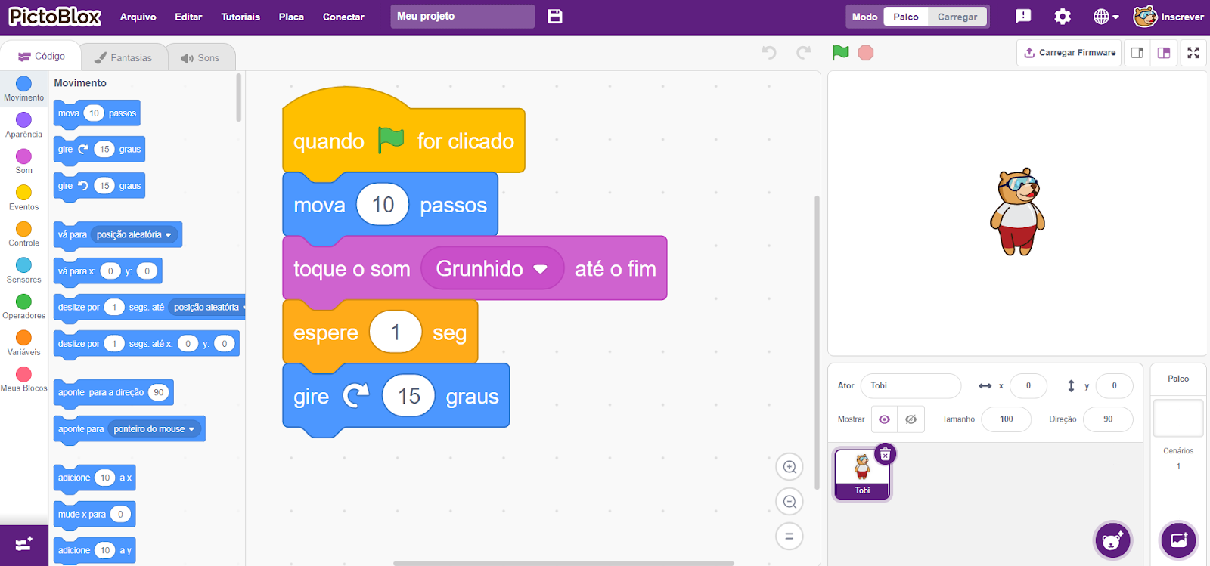
Blocos de comando
Scripts
Palco
Atores
0101010101010101000010100101010101010101010000101011101110100011100010010101010101010101010101010001010101010101010000101001010101010101010100001010111011101000111000100101010101010101010101010100

Slide 8
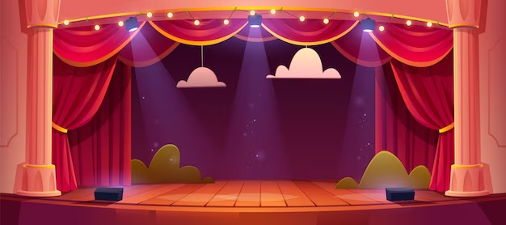

Principais elementos
Imagine o PictoBlox como um teatro…
0101010101010101000010100101010101010101010000101011101110100011100010010101010101010101010101010001010101010101010000101001010101010101010100001010111011101000111000100101010101010101010101010100

Slide 9
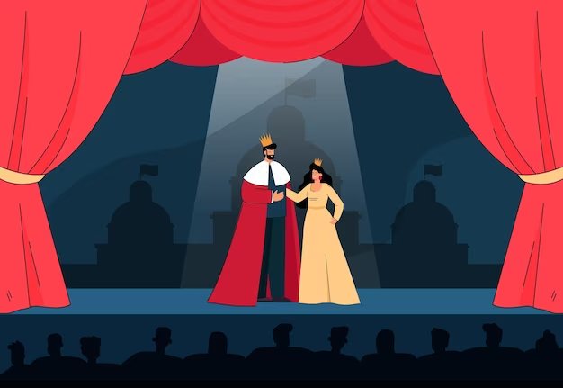
Principais elementos
Imagine o PictoBlox como um teatro…
Para cada cena, há roteiros que os atores aprendem (scripts)
Músicas e efeitos sonoros são comuns!
Os atores podem trocar de roupas (fantasias)
Palco
O palco pode ter vários cenários (planos de fundo)
Atores
Blocos de comando
Formam
Scripts (Roteiros)
0101010101010101000010100101010101010101010000101011101110100011100010010101010101010101010101010001010101010101010000101001010101010101010100001010111011101000111000100101010101010101010101010100

Slide 10

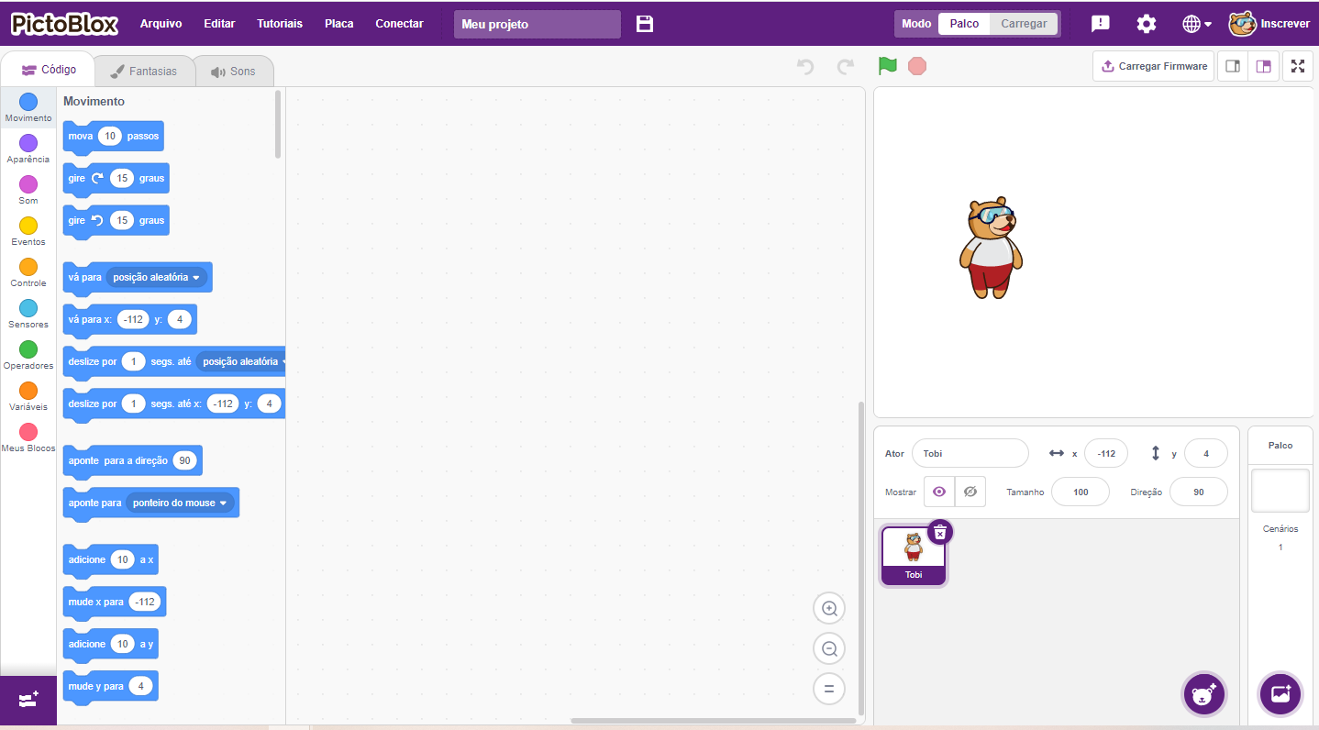
PictoBlox
https://pictoblox.ai/
0101010101010101000010100101010101010101010000101011101110100011100010010101010101010101010101010001010101010101010000101001010101010101010100001010111011101000111000100101010101010101010101010100

Slide 11
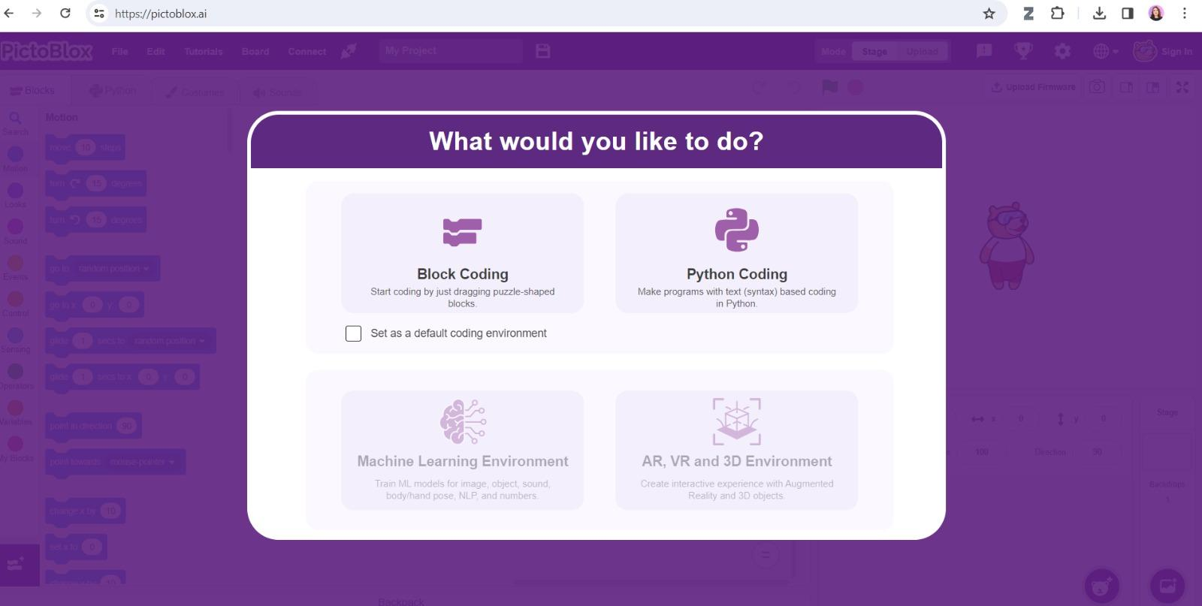
Explorando: Modo de uso
Ao acessar o link anterior, selecione a opção “Block Coding” para aprendermos a programar em blocos.
0101010101010101000010100101010101010101010000101011101110100011100010010101010101010101010101010001010101010101010000101001010101010101010100001010111011101000111000100101010101010101010101010100

Slide 12
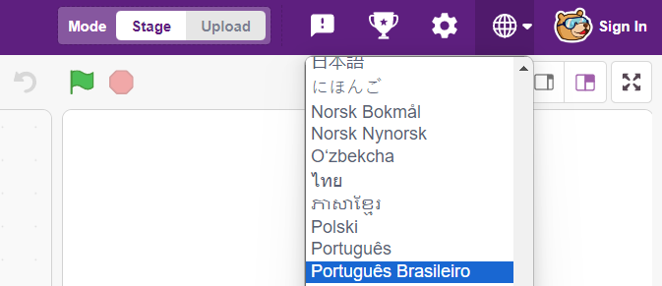
Explorando: Idioma
Pode ser que o ambiente esteja em outro idioma, para mudar basta clicar no ícone do globo, no menu superior direito.
0101010101010101000010100101010101010101010000101011101110100011100010010101010101010101010101010001010101010101010000101001010101010101010100001010111011101000111000100101010101010101010101010100

Slide 13
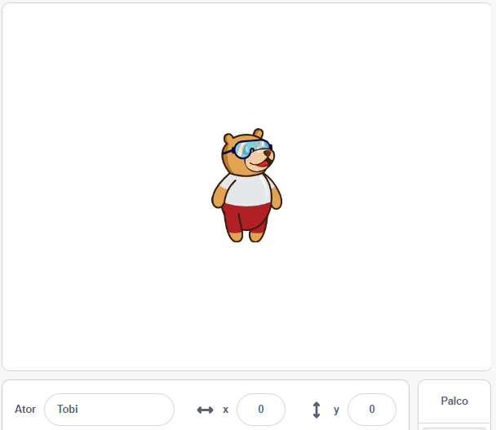
Explorando: Palco
Y
Local em que os atores se movem, são desenhados e interagem;
Ao todo, são 480 passos de largura e 360 de altura;
Coordenadas X e Y.
X
0101010101010101000010100101010101010101010000101011101110100011100010010101010101010101010101010001010101010101010000101001010101010101010100001010111011101000111000100101010101010101010101010100

Slide 14
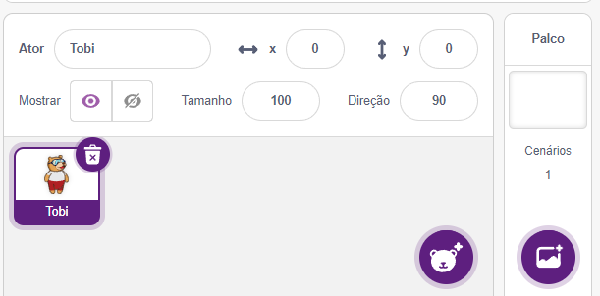
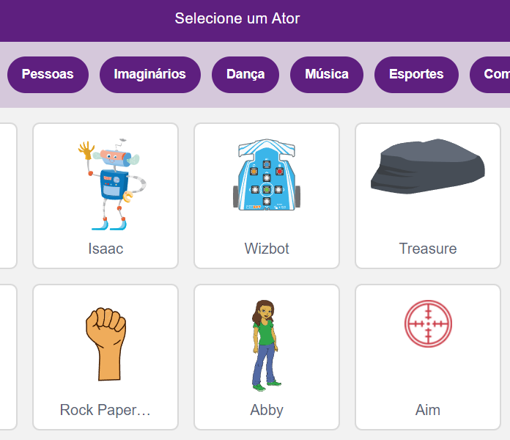
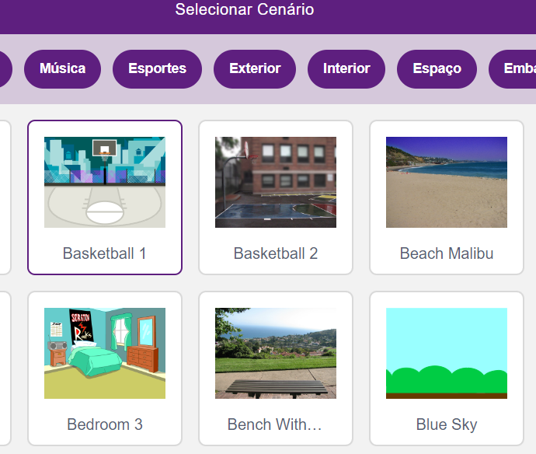
Explorando: Atores e Cenários
Você pode selecionar diferentes atores e cenários.
Selecionar atores
Selecionar cenários
0101010101010101000010100101010101010101010000101011101110100011100010010101010101010101010101010001010101010101010000101001010101010101010100001010111011101000111000100101010101010101010101010100

Slide 15
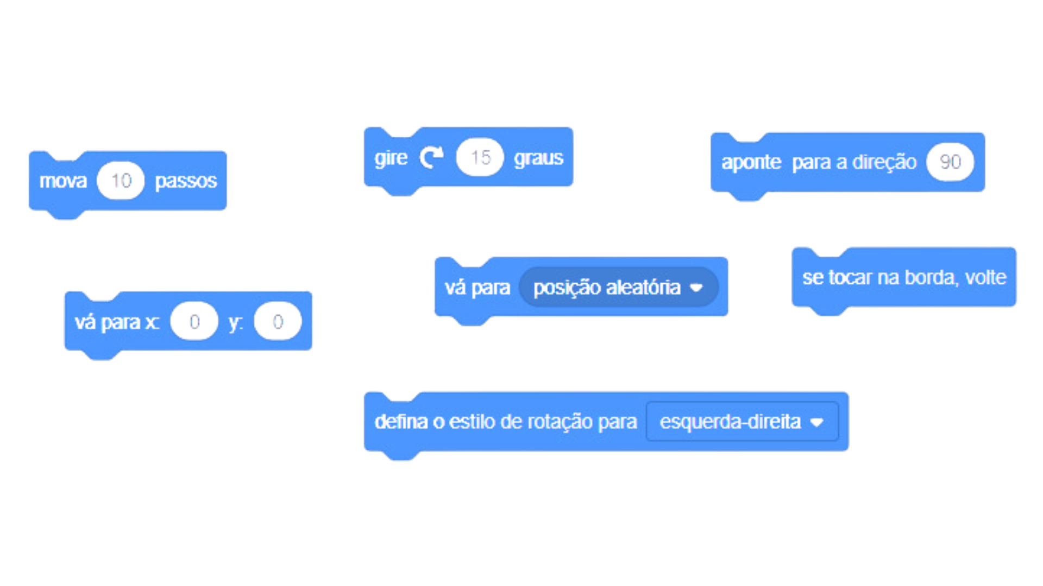

Explorando: Blocos de Comando
Blocos de movimento
Definem como o ator deve se movimentar pelo palco.
0101010101010101000010100101010101010101010000101011101110100011100010010101010101010101010101010001010101010101010000101001010101010101010100001010111011101000111000100101010101010101010101010100

Slide 16
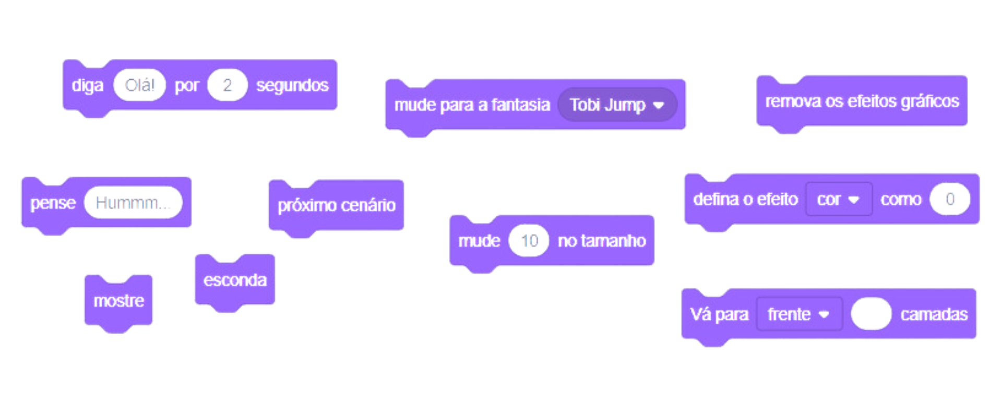

Explorando: Blocos de Comando
Blocos de aparência
Definem como o ator e o palco se apresentam.
0101010101010101000010100101010101010101010000101011101110100011100010010101010101010101010101010001010101010101010000101001010101010101010100001010111011101000111000100101010101010101010101010100

Slide 17

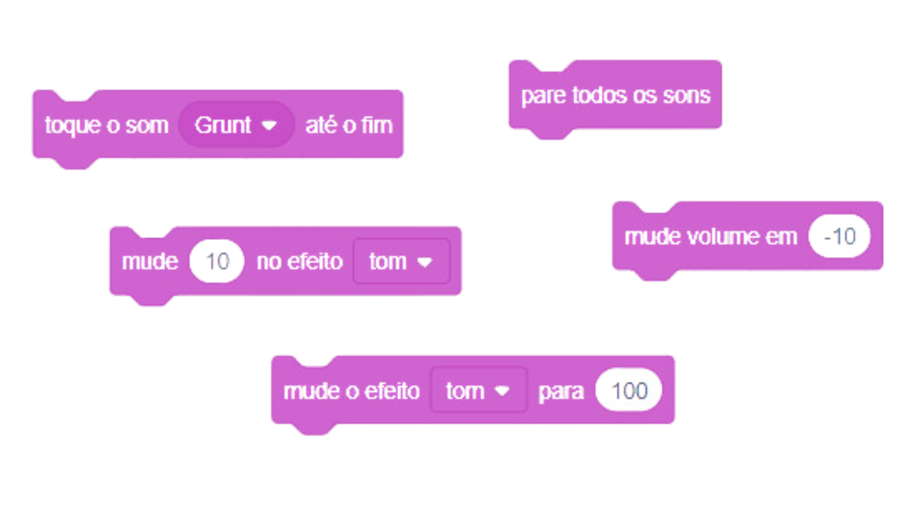
Explorando: Blocos de Comando
Blocos de som
Produzem sons e controlam o volume.
0101010101010101000010100101010101010101010000101011101110100011100010010101010101010101010101010001010101010101010000101001010101010101010100001010111011101000111000100101010101010101010101010100

Slide 18
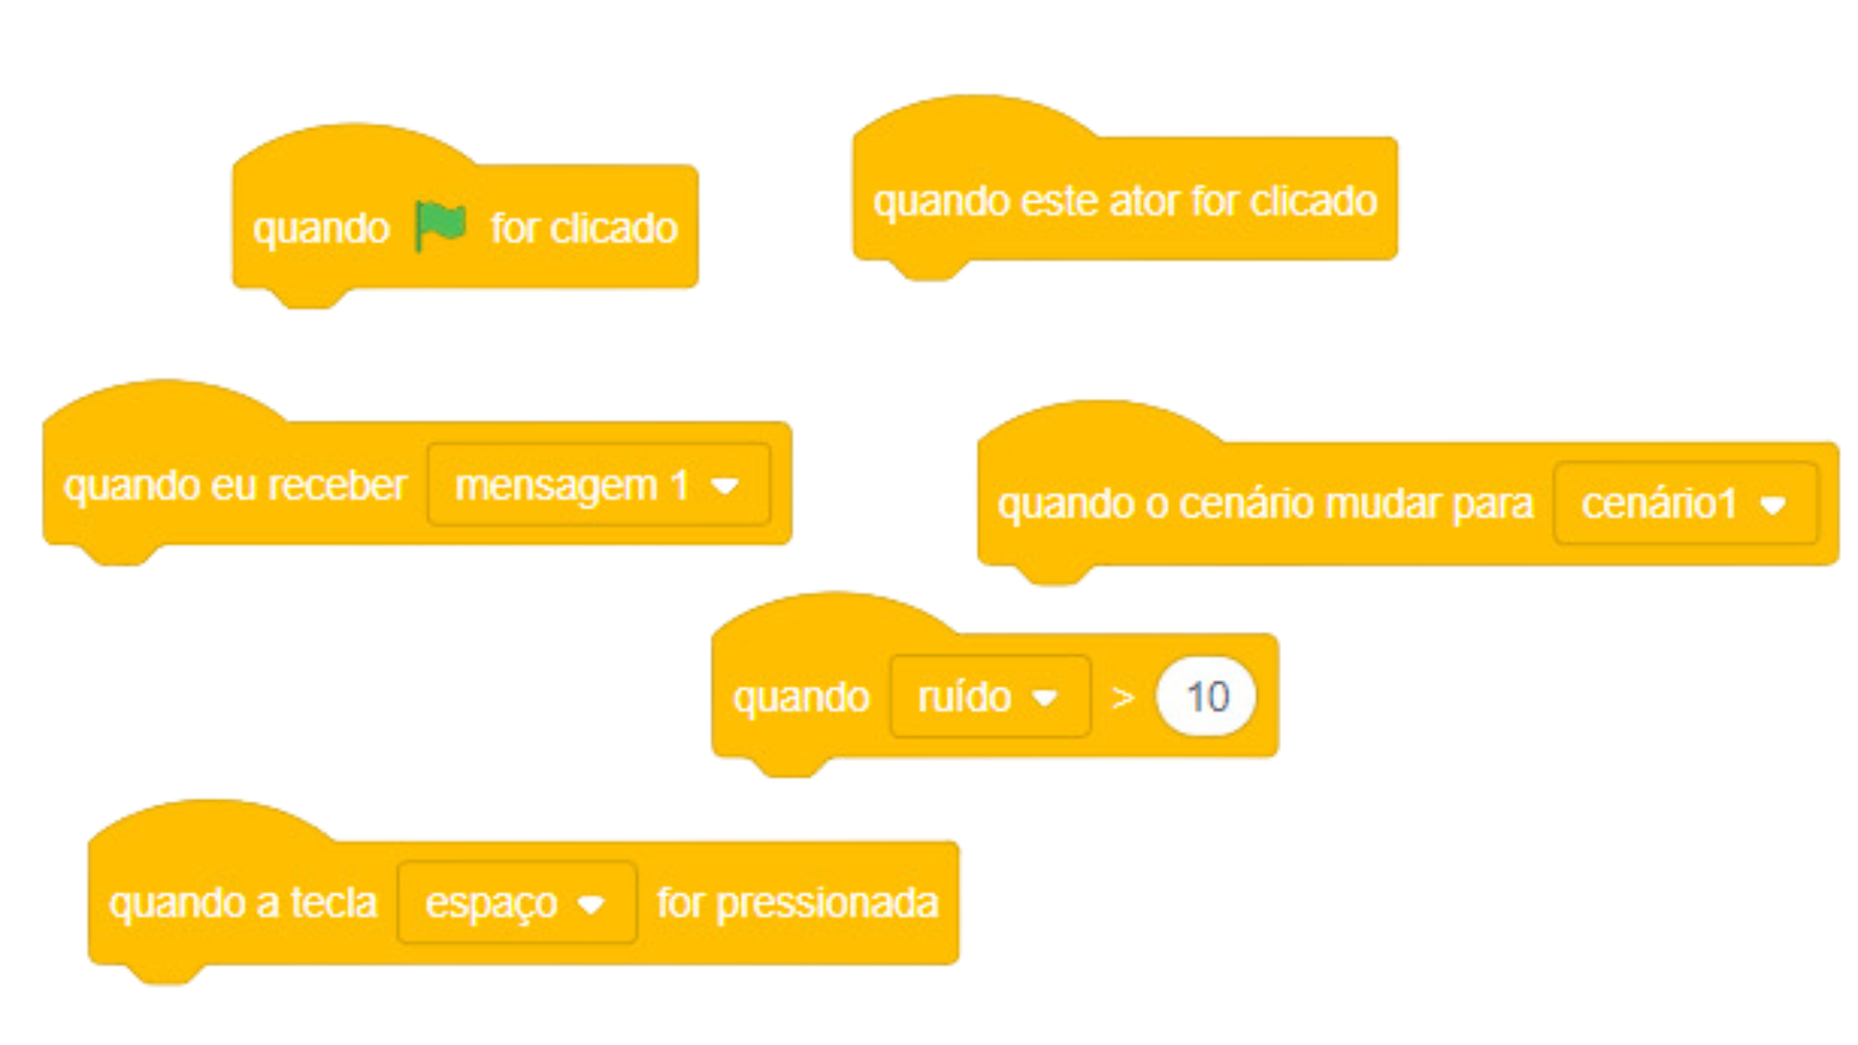

Explorando: Blocos de Comando
Blocos de eventos
Definem eventos para iniciar a execução de um código.
0101010101010101000010100101010101010101010000101011101110100011100010010101010101010101010101010001010101010101010000101001010101010101010100001010111011101000111000100101010101010101010101010100

Slide 19
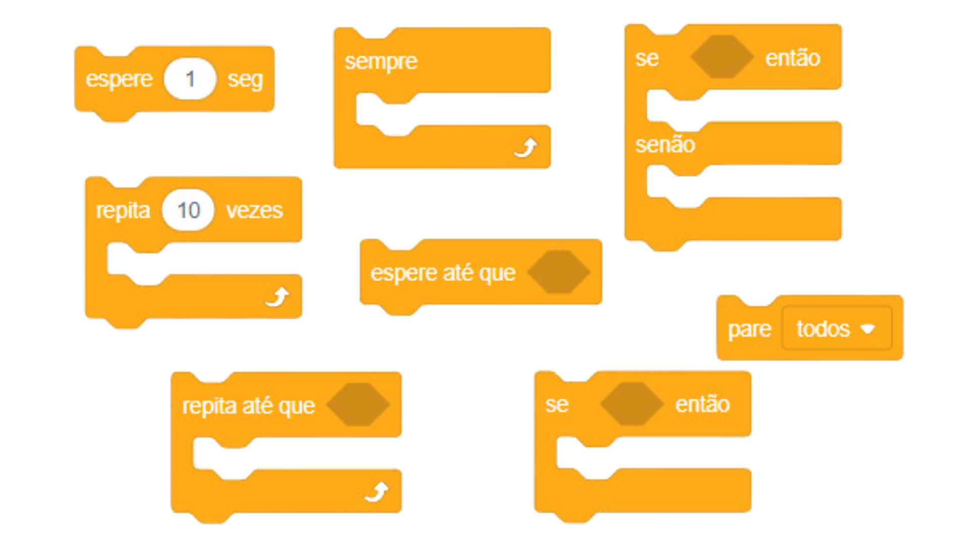

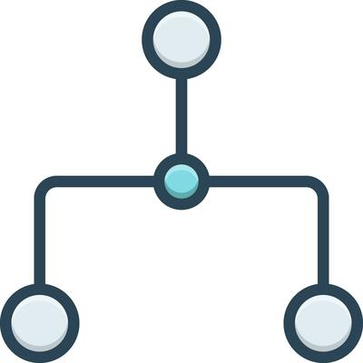
Explorando: Blocos de Comando
Blocos de controle
Controlam outros blocos com condições e repetições.
0101010101010101000010100101010101010101010000101011101110100011100010010101010101010101010101010001010101010101010000101001010101010101010100001010111011101000111000100101010101010101010101010100

Slide 20

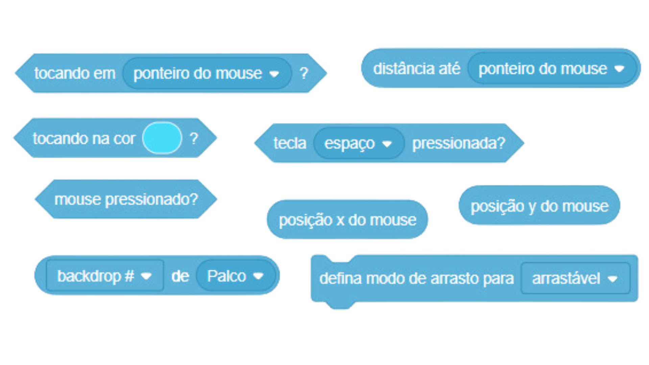
Explorando: Blocos de Comando
Blocos de sensores
Identificam elementos externos.
0101010101010101000010100101010101010101010000101011101110100011100010010101010101010101010101010001010101010101010000101001010101010101010100001010111011101000111000100101010101010101010101010100

Slide 21
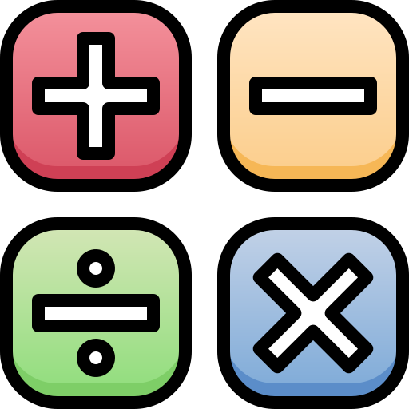
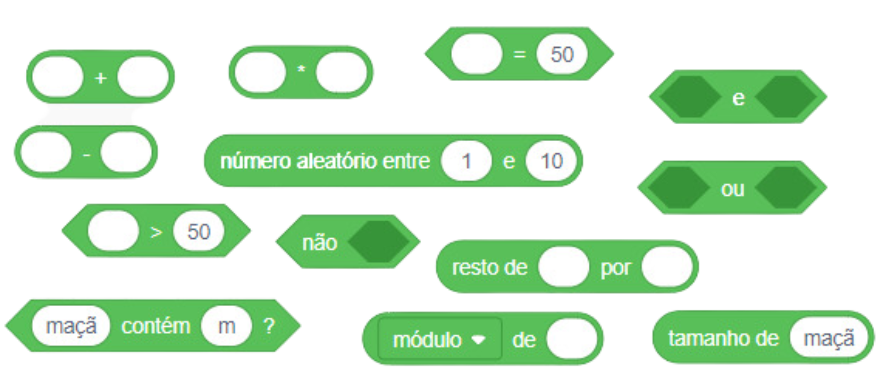
Explorando: Blocos de Comando
Blocos de operadores
Realizam operações matemáticas.
0101010101010101000010100101010101010101010000101011101110100011100010010101010101010101010101010001010101010101010000101001010101010101010100001010111011101000111000100101010101010101010101010100

Slide 22
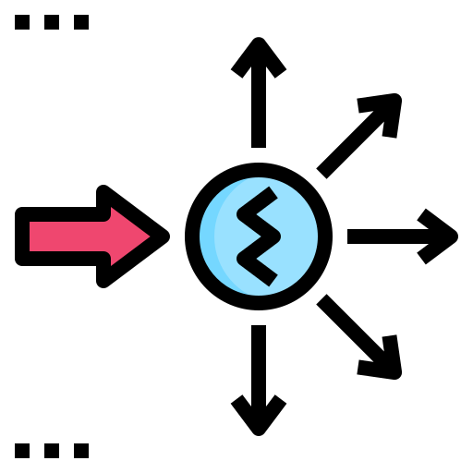
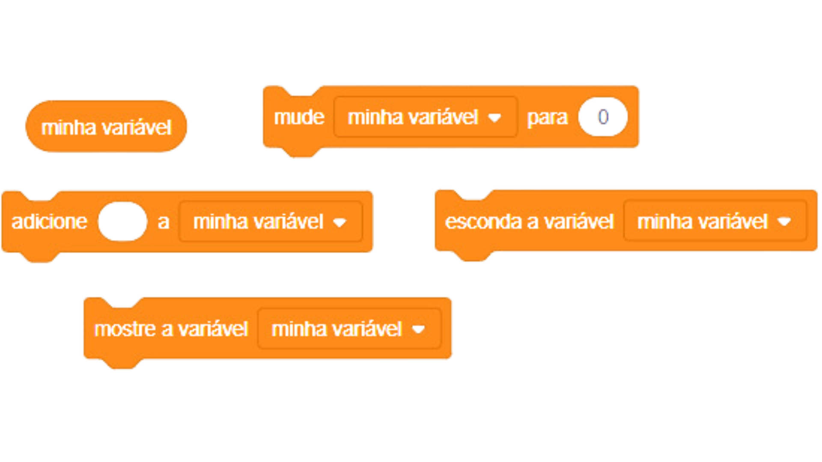
Explorando: Blocos de Comando
Blocos de variáveis
Definem e manipulam variáveis.
0101010101010101000010100101010101010101010000101011101110100011100010010101010101010101010101010001010101010101010000101001010101010101010100001010111011101000111000100101010101010101010101010100

Slide 23

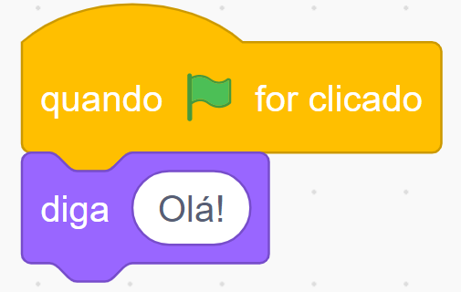
Bloco x Resultado
0101010101010101000010100101010101010101010000101011101110100011100010010101010101010101010101010001010101010101010000101001010101010101010100001010111011101000111000100101010101010101010101010100

Slide 24
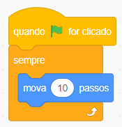
Exemplo #1
1° passo: Vamos fazer o ursinho fazer seu primeiro movimento
Comando inicial padrão (Evento)
Bloco de repetição: toda vez que o jogo for iniciado, executar tal ação (Controle)
Bloco utilizado para mover o ator por 10 passos (Movimento)
0101010101010101000010100101010101010101010000101011101110100011100010010101010101010101010101010001010101010101010000101001010101010101010100001010111011101000111000100101010101010101010101010100

Slide 25
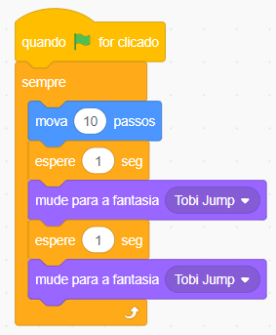
Exemplo #1
2° passo: Adicione blocos de espera e mudança de fantasia
Blocos de espera de 1 segundo (Controle)
Blocos para mudar a fantasia do ator (Aparência)
0101010101010101000010100101010101010101010000101011101110100011100010010101010101010101010101010001010101010101010000101001010101010101010100001010111011101000111000100101010101010101010101010100

Slide 26
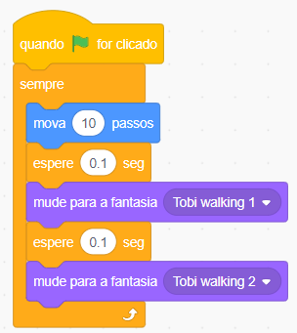
Exemplo #1
3° passo: Alterar valores de espera e fantasia
Alterar valores para 0.1 segundos
Selecionar fantasia “Tobi walking 1”
Selecionar fantasia “Tobi walking 2”
0101010101010101000010100101010101010101010000101011101110100011100010010101010101010101010101010001010101010101010000101001010101010101010100001010111011101000111000100101010101010101010101010100

Slide 27
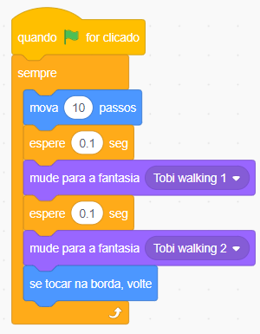
Exemplo #1
4° passo: Adicionar bloco de volta ao tocar a borda
Bloco para o personagem voltar ao tocar a borda do palco (Movimento)
0101010101010101000010100101010101010101010000101011101110100011100010010101010101010101010101010001010101010101010000101001010101010101010100001010111011101000111000100101010101010101010101010100

Slide 28
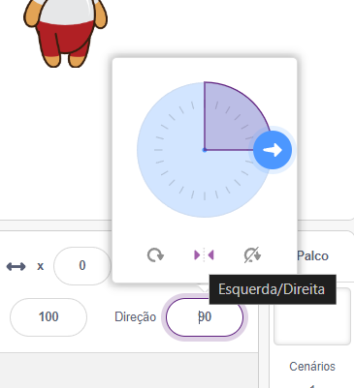
Exemplo #1
5° passo: Alterar a direção de giro
Para que o ator ande para frente e, ao tocar a borda, gire para trás temos que alterar o ângulo de direção para Esquerda/Direita
Selecionar para alterar a direção de giro
0101010101010101000010100101010101010101010000101011101110100011100010010101010101010101010101010001010101010101010000101001010101010101010100001010111011101000111000100101010101010101010101010100

Slide 29
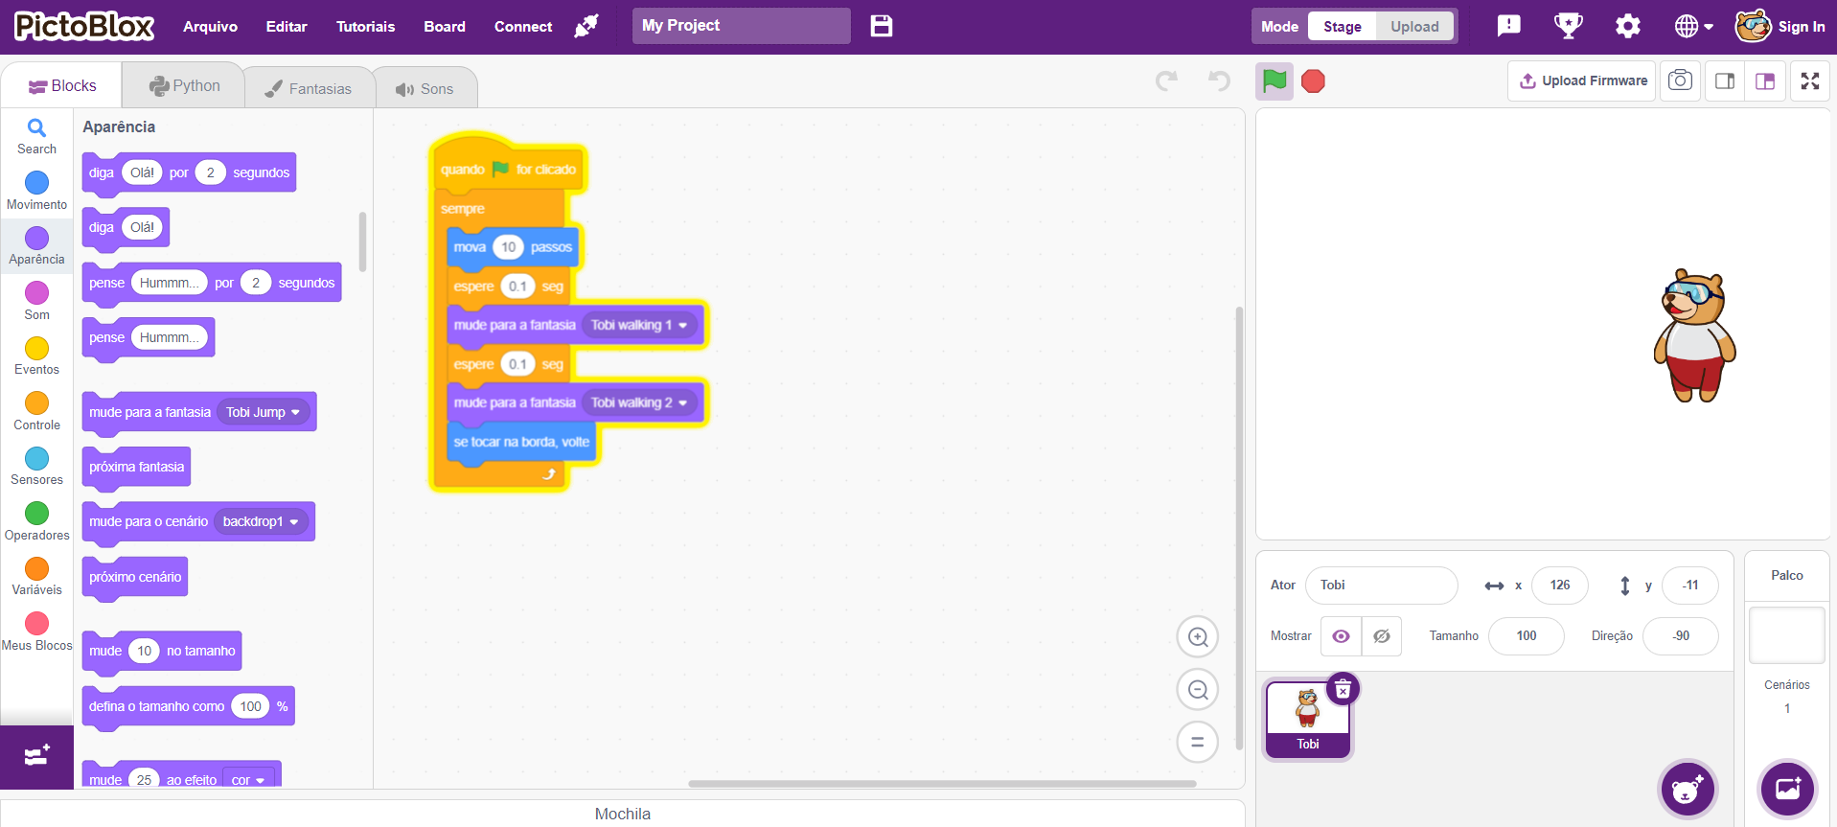
Exemplo #1
0101010101010101000010100101010101010101010000101011101110100011100010010101010101010101010101010001010101010101010000101001010101010101010100001010111011101000111000100101010101010101010101010100

Slide 30
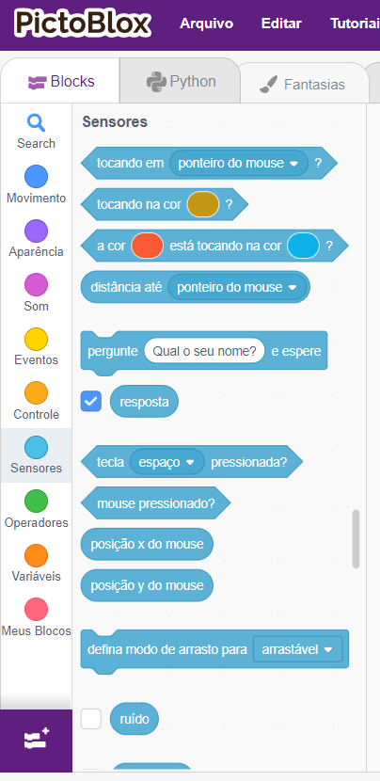
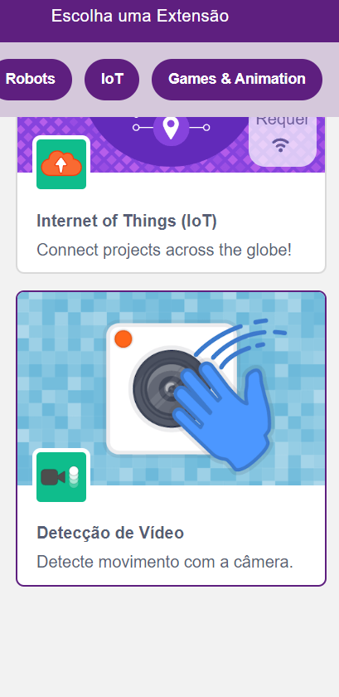
Interagindo com elementos externos
No PictoBlox, temos algu- mas ferramentas que nos permitem interagir com um programa;
Alguns exemplos são os sensores e as extensões como a de Detecção de Vídeo.
Adicionar extensões
0101010101010101000010100101010101010101010000101011101110100011100010010101010101010101010101010001010101010101010000101001010101010101010100001010111011101000111000100101010101010101010101010100

Slide 31

Interagindo com elementos externos
Com a extensão Detecção de Vídeo, o PictoBlox pode usar movimentos detectados a partir da webcam para realizar alguma atividade programada;
Na aba “Tutoriais”, no menu superior esquerdo, você encontra o passo a passo de como utilizar a extensão;
Você terá acesso a vários outros tutoriais nessa aba como Jogo tipo Pong e Crie uma História.
0101010101010101000010100101010101010101010000101011101110100011100010010101010101010101010101010001010101010101010000101001010101010101010100001010111011101000111000100101010101010101010101010100

Slide 32
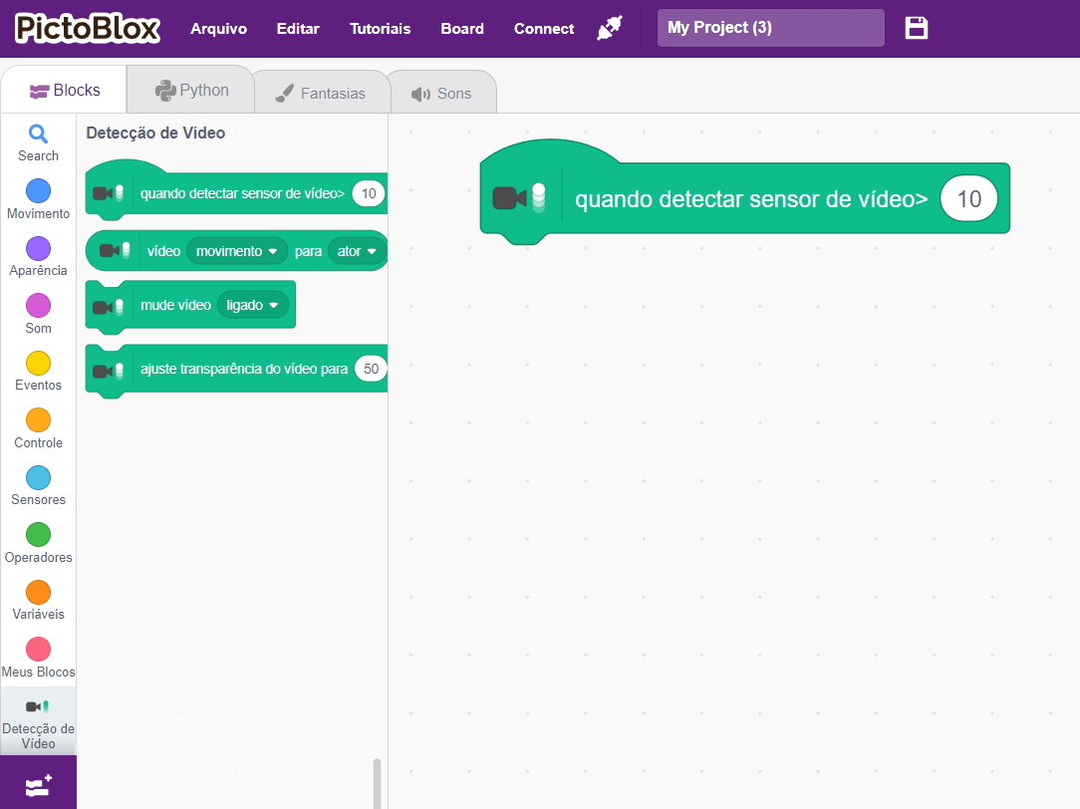
Interagindo com elementos externos
Aba “Tutoriais”
Novos blocos da extensão
0101010101010101000010100101010101010101010000101011101110100011100010010101010101010101010101010001010101010101010000101001010101010101010100001010111011101000111000100101010101010101010101010100

Slide 33
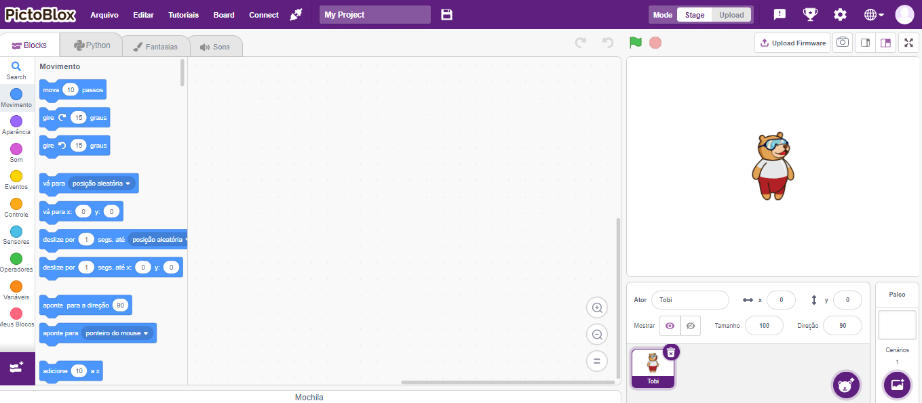
Exemplo #2
1° passo: Apagar o ator inicial do Pictoblox
0101010101010101000010100101010101010101010000101011101110100011100010010101010101010101010101010001010101010101010000101001010101010101010100001010111011101000111000100101010101010101010101010100

Slide 34
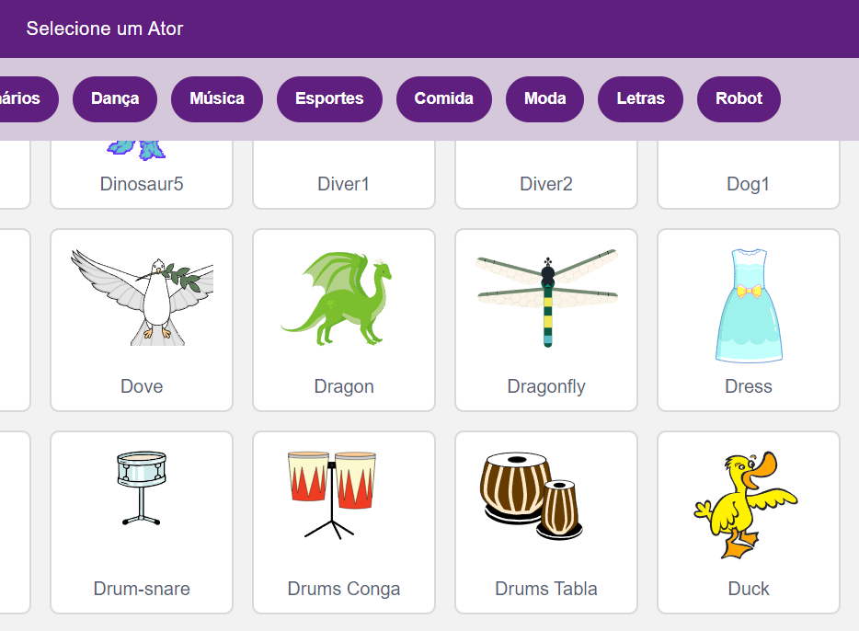
Exemplo #2
2° passo: Selecionar o ator “Dragon”
Selecionar atores
0101010101010101000010100101010101010101010000101011101110100011100010010101010101010101010101010001010101010101010000101001010101010101010100001010111011101000111000100101010101010101010101010100

Slide 35
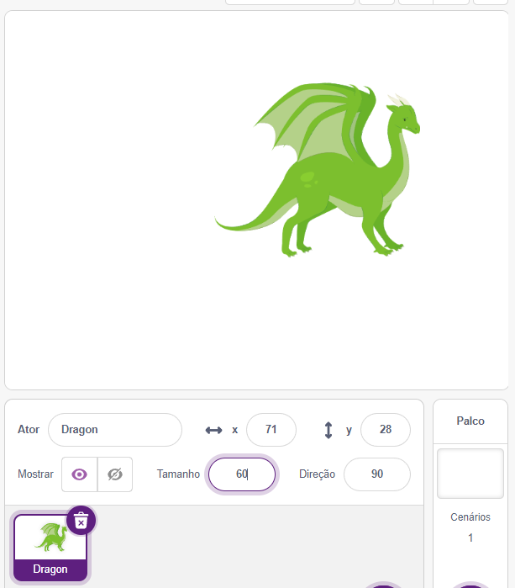
Exemplo #2
3° passo: Reduzir o tamanho do ator e movê-lo
Altere o tamanho para 60
Clique no ator e mova-o para qualquer canto do palco
0101010101010101000010100101010101010101010000101011101110100011100010010101010101010101010101010001010101010101010000101001010101010101010100001010111011101000111000100101010101010101010101010100

Slide 36
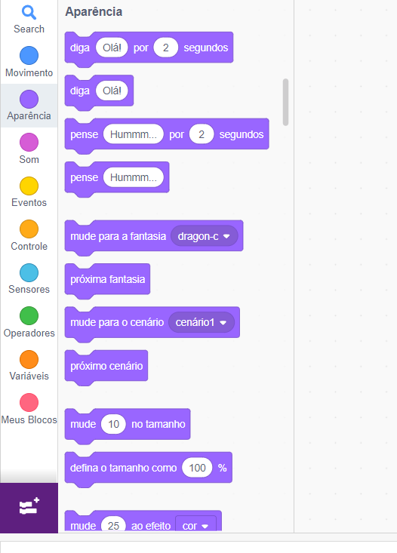
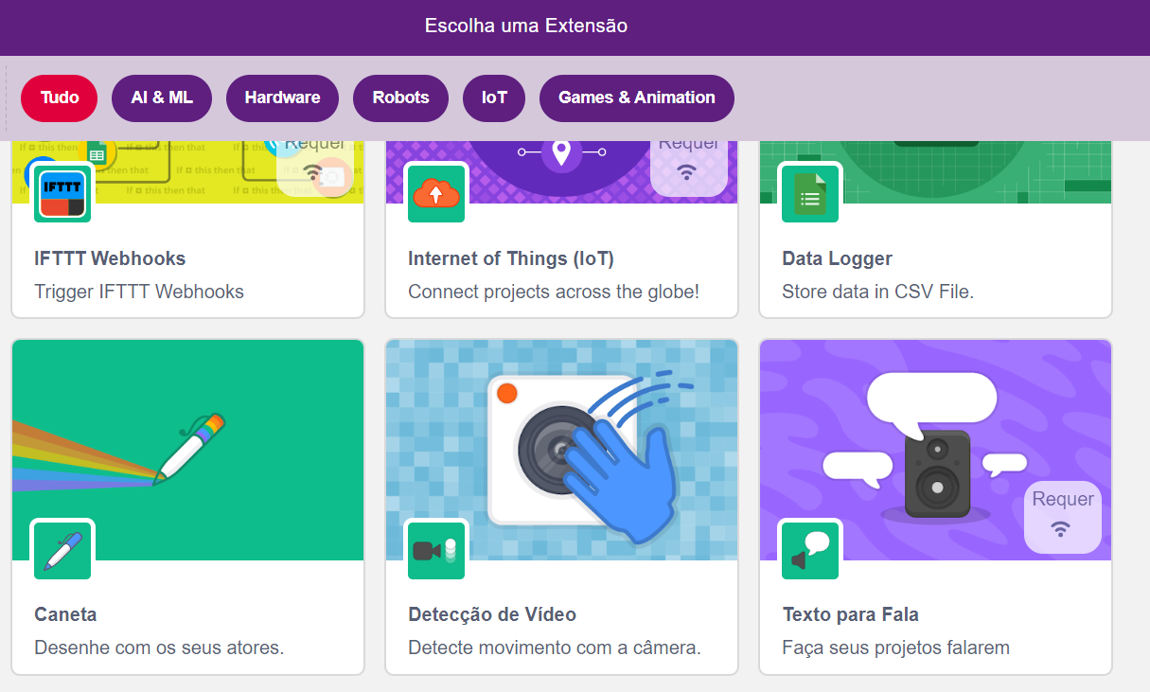
Exemplo #2
4° passo: Adicionar a extensão “Detecção de Vídeo”
Adicionar extensão
0101010101010101000010100101010101010101010000101011101110100011100010010101010101010101010101010001010101010101010000101001010101010101010100001010111011101000111000100101010101010101010101010100

Slide 37
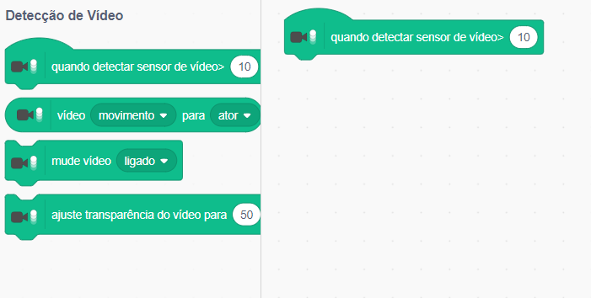
Exemplo #2
5° passo: Adicionar o bloco de detecção de movimento no vídeo da webcam
Quando a intensidade de movimento no vídeo da webcam no local do ator for superior a 10, os comandos vão iniciar
0101010101010101000010100101010101010101010000101011101110100011100010010101010101010101010101010001010101010101010000101001010101010101010100001010111011101000111000100101010101010101010101010100

Slide 38
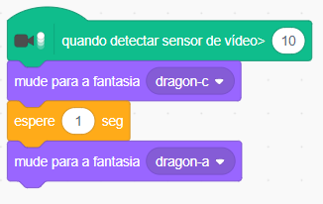
Exemplo #2
6° passo: Adicionar blocos de mudança de fantasia e espera entre elas
Bloco para mudar a fantasia do ator (Aparência)
Bloco de espera de 1 segundo (Controle)
Selecionar fantasia “dragon-a”
0101010101010101000010100101010101010101010000101011101110100011100010010101010101010101010101010001010101010101010000101001010101010101010100001010111011101000111000100101010101010101010101010100

Slide 39
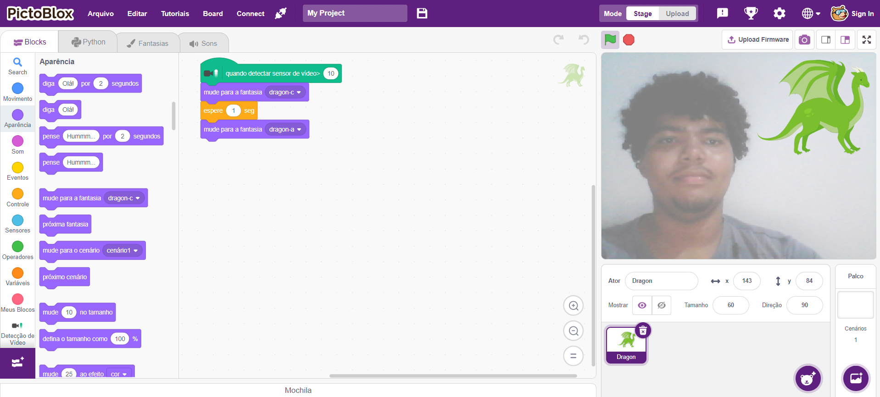
Exemplo #2
0101010101010101000010100101010101010101010000101011101110100011100010010101010101010101010101010001010101010101010000101001010101010101010100001010111011101000111000100101010101010101010101010100

Slide 40
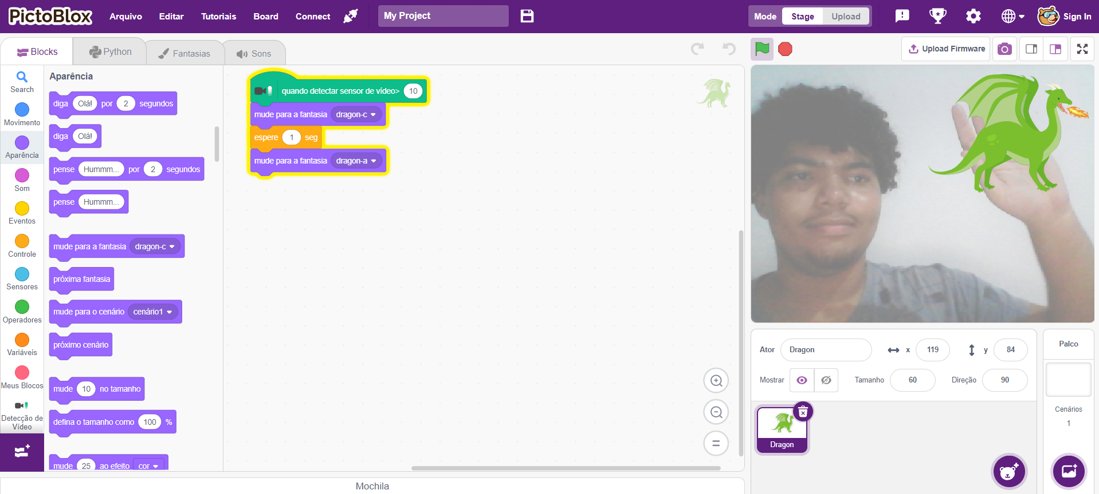
Exemplo #2
0101010101010101000010100101010101010101010000101011101110100011100010010101010101010101010101010001010101010101010000101001010101010101010100001010111011101000111000100101010101010101010101010100

Slide 41
Exemplo #3
1° passo: Apagar o ator inicial do Pictoblox
0101010101010101000010100101010101010101010000101011101110100011100010010101010101010101010101010001010101010101010000101001010101010101010100001010111011101000111000100101010101010101010101010100

Slide 42
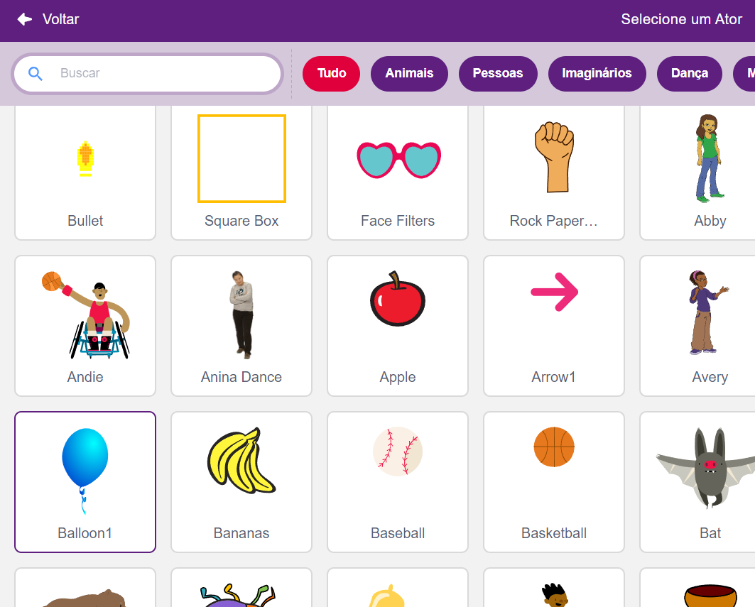
Exemplo #3
2° passo: Selecionar o ator “Ballon1”
Selecionar atores
0101010101010101000010100101010101010101010000101011101110100011100010010101010101010101010101010001010101010101010000101001010101010101010100001010111011101000111000100101010101010101010101010100

Slide 43
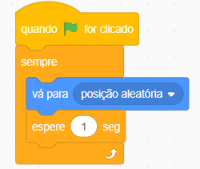
Exemplo #3
3° passo: Mover o ator por posições aleatórias do palco
Bloco para mover o ator para posições aleatórias do palco (Movimento)
0101010101010101000010100101010101010101010000101011101110100011100010010101010101010101010101010001010101010101010000101001010101010101010100001010111011101000111000100101010101010101010101010100

Slide 44
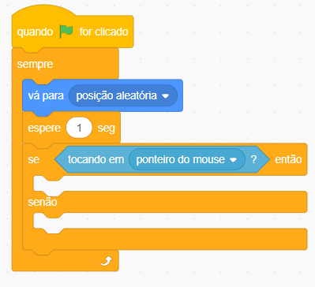
Exemplo #3
4° passo: Adicionar estrutura condicional e bloco sensor
Bloco sensor que identifica se o ator está tocando o ponteiro do mouse (Sensores)
Bloco que estabelece uma condição que, se atendida, executa uma ação, e em caso negativo, executa outra ação (Controle)
0101010101010101000010100101010101010101010000101011101110100011100010010101010101010101010101010001010101010101010000101001010101010101010100001010111011101000111000100101010101010101010101010100

Slide 45
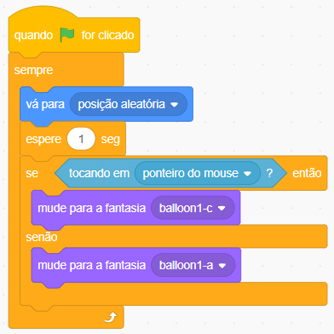
Exemplo #3
5° passo: Adicionar blocos de mudança de fantasia nas condicionais
Selecionar fantasia “ballon1-a”
0101010101010101000010100101010101010101010000101011101110100011100010010101010101010101010101010001010101010101010000101001010101010101010100001010111011101000111000100101010101010101010101010100

Slide 46
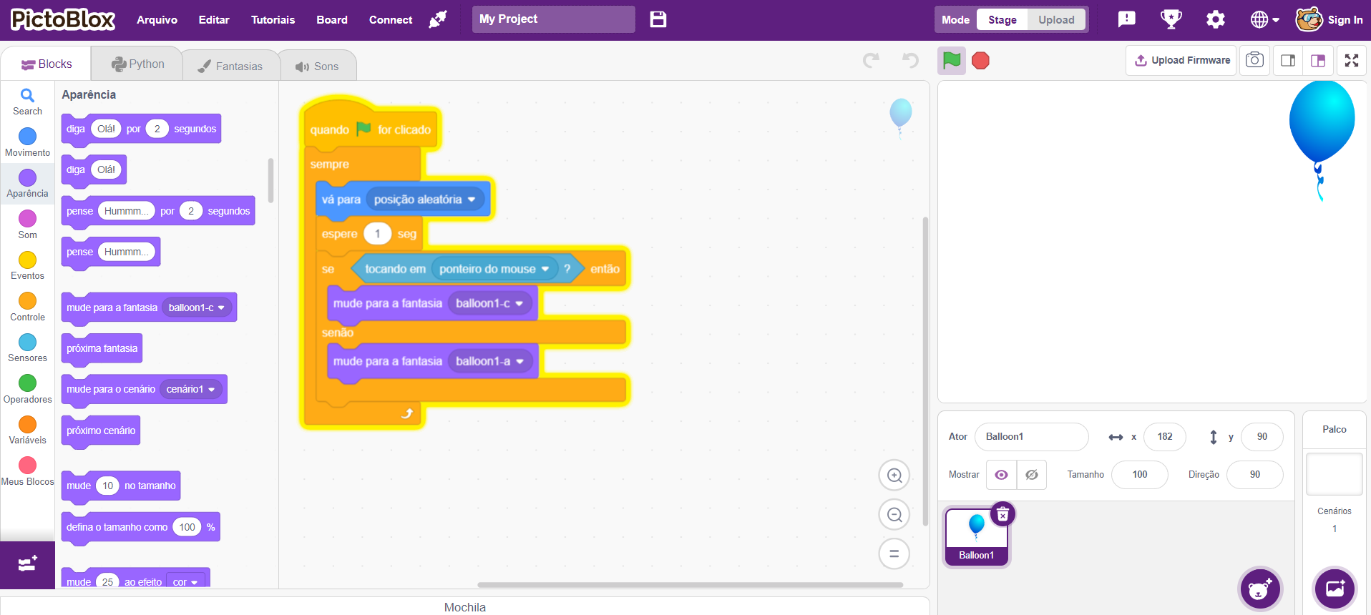
Exemplo #3
0101010101010101000010100101010101010101010000101011101110100011100010010101010101010101010101010001010101010101010000101001010101010101010100001010111011101000111000100101010101010101010101010100

Slide 47
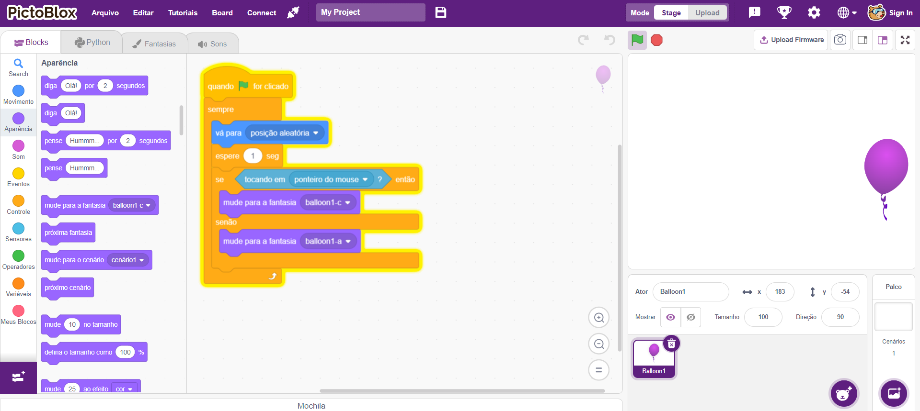

Exemplo #3
0101010101010101000010100101010101010101010000101011101110100011100010010101010101010101010101010001010101010101010000101001010101010101010100001010111011101000111000100101010101010101010101010100

Slide 48

BORA PRATICAR!

Slide 49

Atividade
Vamos aplicar nossos conhecimentos em programação em blocos com a ferramenta PictoBlox;
Para realizar esta atividade acesse o PictoBlox pelo link abaixo e crie uma história onde seu personagem (você escolhe o ator) se apresenta e conta o seu principal hobby;
Explore diferentes atores, cenários e comandos.
https://pictoblox.ai/
0101010101010101000010100101010101010101010000101011101110100011100010010101010101010101010101010001010101010101010000101001010101010101010100001010111011101000111000100101010101010101010101010100

Slide 50





Dúvidas e perguntas?!
@nepeti.ce
informatica.ifgoiano.edu.br

Slide 51




Material Licenciado
Este documento está licenciado sob uma licença Creative Commons CC BY-NC-SA 4.0.
Texto da licença: https://creativecommons.org/licenses/by-nc-sa/4.0/deed.pt-br
Esta licença permite que outros remixem, adaptem e criem a partir do seu trabalho para fins não comerciais, desde que atribuam a você o devido crédito e que licenciem as novas criações sob termos idênticos.
Atribuição — Você deve dar o crédito apropriado, prover um link para a licença e indicar se mudanças foram feitas.
NãoComercial — Você não pode usar o material para fins comerciais.
CompartilhaIgual — Se você remixar, transformar, ou criar a partir do material, tem de distribuir as suas contribuições sob a mesma licença que o original.
0101010101010101000010100101010101010101010000101011101110100011100010010101010101010101010101010001010101010101010000101001010101010101010100001010111011101000111000100101010101010101010101010100

